Slide 1
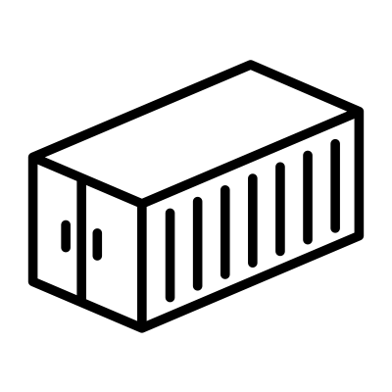
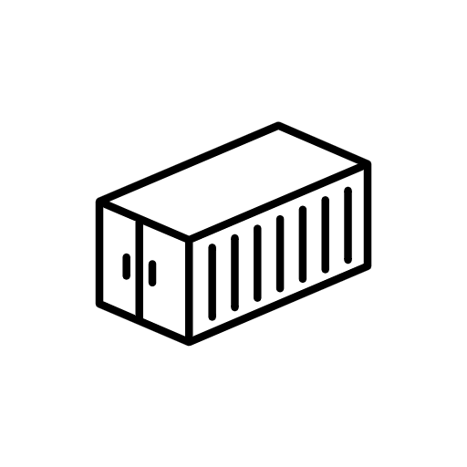
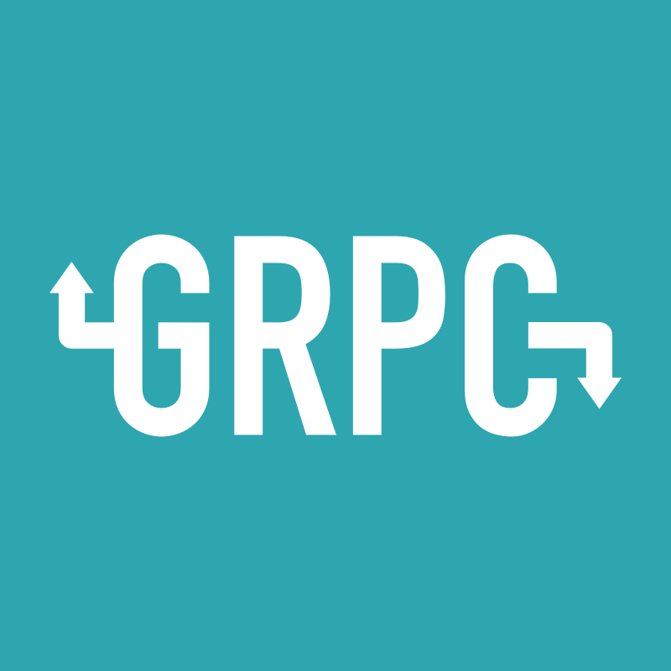


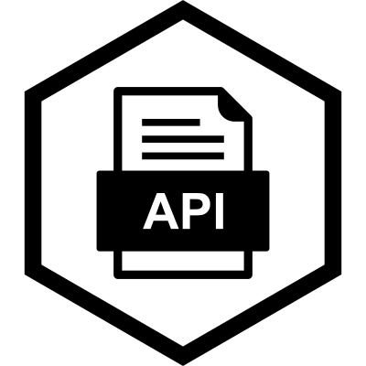




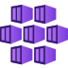



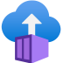



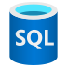






Slide 2

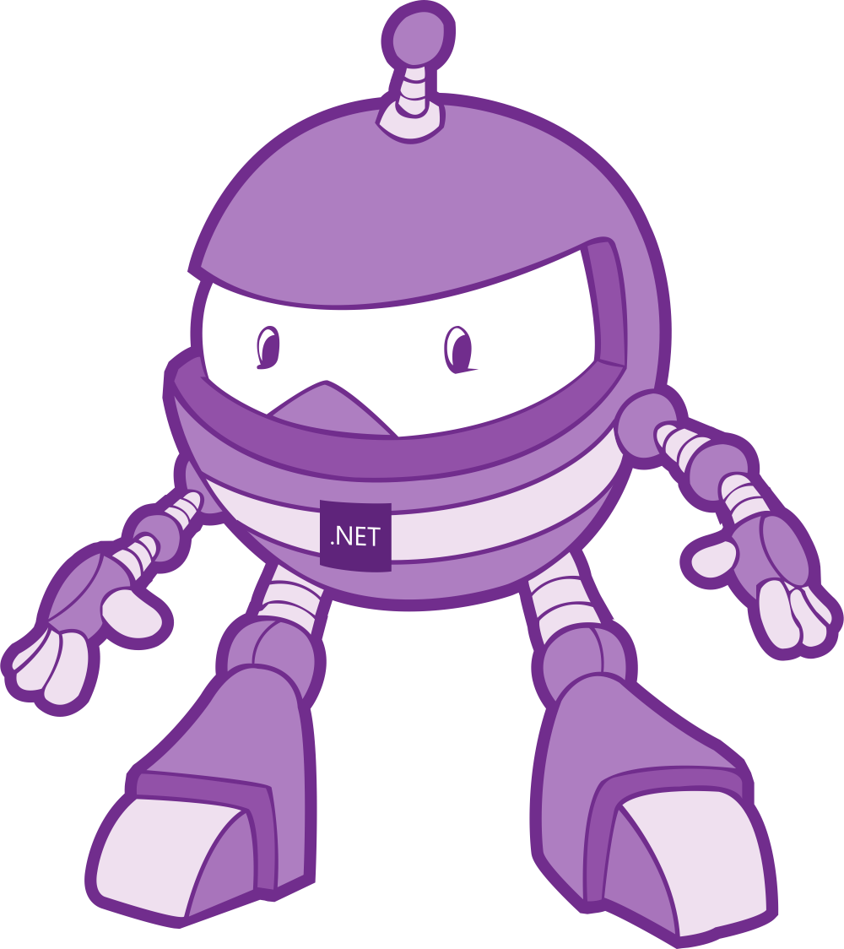
.NET as Cloud Native
Using .NET Core, Azure Services, and Kubernetes Together
Glenn Condron
Principal Program Manager Lead
@condrong
Brady Gaster
Senior Program Manager
@bradygaster
https://aka.ms/cloudnativedotnetworkshop

Slide 3
Prerequisites
General
Windows
Mac
Azure Subscription
Docker
Kubernetes
Azure Functions tools
Azure Storage Explorer
Visual Studio 2019
.NET Core 3.0
Visual Studio for Mac
Visual Studio Code
Azure CLI
Helm
Helpful Visual Studio Code Extensions
Azure Storage | Azure App Service | Cosmos DB
Azure API Management | Azure CLI Tools | Docker
https://aka.ms/cloudnativedotnetworkshop

Slide 4
Agenda
Intro
Setup
Serverless
Lunch
Microservices
Hack
Q&A
https://aka.ms/cloudnativedotnetworkshop

Slide 5
Things you’ll use today
.NET Core
Worker Service
Azure
Durable Functions
General
Helm
Docker
Kubernetes
gRPC Services
REST APIs
Blazor
Functions SDK
SignalR
Azure Kubernetes Service
Azure Container Registry
Azure App Config
VS/VS Code Tools
Azure CLI
Azure SignalR Service
Azure Storage
Storage Client SDK
Cosmos Client SDK
Azure App Service
Azure Functions CLI
Azure Container Instances
https://aka.ms/cloudnativedotnetworkshop

Slide 6
Cloud-based Loan Processing
An overview of the solution
https://aka.ms/cloudnativedotnetworkshop

Slide 7
serverless
microservices

Slide 8
serverless
or
microservices

Slide 9
serverless
or
microservices

Slide 10
serverless
&
microservices

Slide 11


Start Durable Orchestration
Update UI
Http Triggered
Azure Function
Blazor UI Dashboard
Currency Converter API

Slide 12


Start Durable Orchestration
Update UI
Agency check
Agency check
Agency check
Durable Http request to API
Http Triggered
Azure Function
Update UI
Update UI
Update UI
Blazor UI Dashboard
To-be-approved loan feed
Loan inbox RESTful API
Currency Converter API
Loan inbox queue worker
Azure Cosmos
Azure Storage Queue

Slide 13
serverless
&
microservices

Slide 14
serverless

Slide 15
server
less

Slide 16
What is the right size of
servers for my business needs?
How do I deploy new code to my server?
What media should I
use to keep backup?
What happens in case of
server hardware failure?
Which packages should be on my server?
What size of servers
should I buy?
Who monitors
my app?
How often should I backup my server?
How can I scale my app?
How can I increase server utilization?
Who has physical
access to my servers?
Which OS should I use?
Do I need secondary network connection?
Are my server in a
secure location?
What happens if the
power goes out?
Who monitors
my Servers?
Do I need a UPS?
What storage I need to use?
How many servers
do I need?
How can I dynamically configure my app?
It takes how long to provision a new server?
How often should
I patch my servers?
On-premises
The “evolution” of application platforms
Notes:
There is so much talk about the cloud that sometimes it’s easy to forget it all began (and still exists) in the data center. Fortunately, not many of us have to configure physical servers and install them in the data center. Taking on that responsibility means a lot of questions to answer. Everything from “how do I secure physical access” to “what happens when the power goes out?” These are questions and steps that distract from the focus of building good software but must be addressed for on-premises installations to be successful.

Slide 17
What is the right size of servers for my business needs?
How can I increase server utilization?
How many servers do I need?
How can I scale my app?
How often should I patch my servers?
How do I deploy new code to my server?
How often should I backup my server?
Which OS should I use?
Which packages should be on my server?
Who monitors my app?
On-premises
IaaS
The “evolution” of application platforms
Notes:
Fortunately virtualization came to the rescue. One great thing about the cloud evolution is that each phase leads to less waste. Infrastructure as a Service leverages hardware in a way that you can stop worrying about the hardware and focus on the operating system and your virtual machines. You can get better utilization of your resources and it’s faster and easier to provision new instances. IaaS addresses many of the questions we dealt with on-premises, and more importantly paves the way to the cloud.

Slide 18
What is the right size of “servers” for my business needs?
How can I increase “server” utilization?
How many “servers” do I need?
How can I scale my app?
On-premises
IaaS
PaaS
The “evolution” of application platforms
Notes:
Platform-as-a-Service is the next evolution: host a runtime, so we stop worrying about hardware and operating system and even dependencies and just focus on our project. We’re no longer in the business of constantly patching an OS or even making sure dependencies are installed to run a web server or host a process. PaaS simplifies the process even more and provides a mature platform for code that must run at scale because you can still size (scale up) and specify instances (scale out) to manage your workloads.

Slide 19
How do I architect my app?
Serverless, the platform for cloud native apps
On-Premises
IaaS
PaaS
Serverless
The “evolution” of application platforms
Notes:
Serverless takes us to the ultimate cloud native experience: we simply focus on code. It doesn’t mean there is no server, because we still need to run on infrastructure, but the infrastructure is further abstracted so there is less server in our scope of responsibility and more code. We focus on what is unique for our business and spend more time on innovation, less time on answering the myriad questions that exist with the previous phases. Serverless is cloud native. But what does that really mean?

Slide 20
What is Serverless?
$
Abstraction of servers
Event-driven/ instant scale
Micro-billing
Notes:
With serverless, the server, including hardware, infrastructure and configuration of the operating system are all abstracted away. You don’t even have to worry about a web service because it’s provided as part of the platform.
Serverless compute is a fully managed service. Some refer to it as Functions as a Service
OS and Framework patching is performed for you
There is zero administrative tasks and no need to manage any infrastructure
You just deploy your code (function) and it runs
Your code runs within seconds and for typically shorter periods of times (minutes vs. hours or days)
Serverless compute scales quickly (almost instantly) and vastly
Automatically scales within seconds
No scale configuration is required (there is no way to configure scale or limits)
Scales to match any given workload. Scales from zero to handle tens of thousands concurrent functions invocations within seconds
Pay only for the time your code is running
Serverless compute reacts to events
React, in near real-time, to events and triggers
Triggered by virtually any event from both inside and outside of Azure
A key differentiator about serverless is micro-billing. Serverless resources are billed only when used. That means that you aren’t paying to anticipate an increase in workload, but only when the workload hits. Serverless scales with your business. Let’s take a closer look at micro-billing.

Slide 21
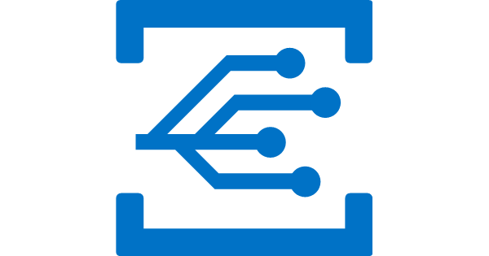

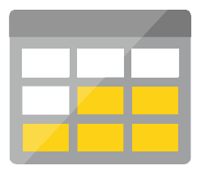
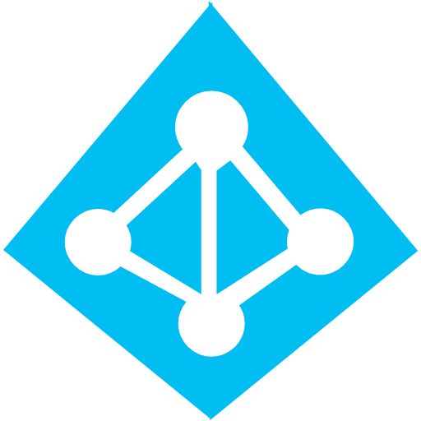
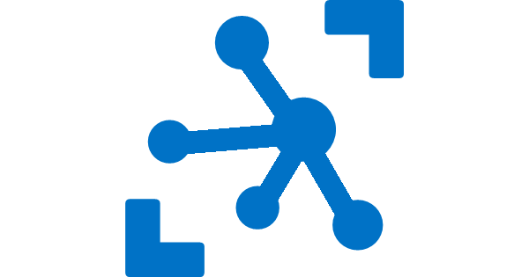


Azure serverless platform components
Platform
Event Grid
Logic Apps
Functions
Manage all events that can trigger code or logic
Design workflows and orchestrate processes
Execute your code based on events you specify
Database
Storage
Security
IoT
Analytics
Intelligence
Notes:
All of these services interoperate seamlessly with other Azure platform components, including databases like Azure SQL and Cosmos DB, storage services, security and identity, IoT, analytics, and even artificial intelligence. We’ll explore a machine learning integration later on.

Slide 22
Azure serverless platform components
Development
Platform
IDE support
Event Grid
Logic Apps
Functions
</>
Manage all events that can trigger code or logic
Design workflows and orchestrate processes
Execute your code based on events you specify
Integrated DevOps
Local development
Monitoring
Database
Storage
Security
IoT
Analytics
Intelligence
Visual debug history
Notes:
Of course developers want to be able to develop and test services locally, without an Internet connection, integrate these services with a mature DevOps pipeline and be able to both monitor and debug services that are already deployed to production. All of the Azure serverless platform components plug into your favorite development environment and enable local testing and remote debugging and telemetry.

Slide 23
Logic Apps & Flow

Slide 24

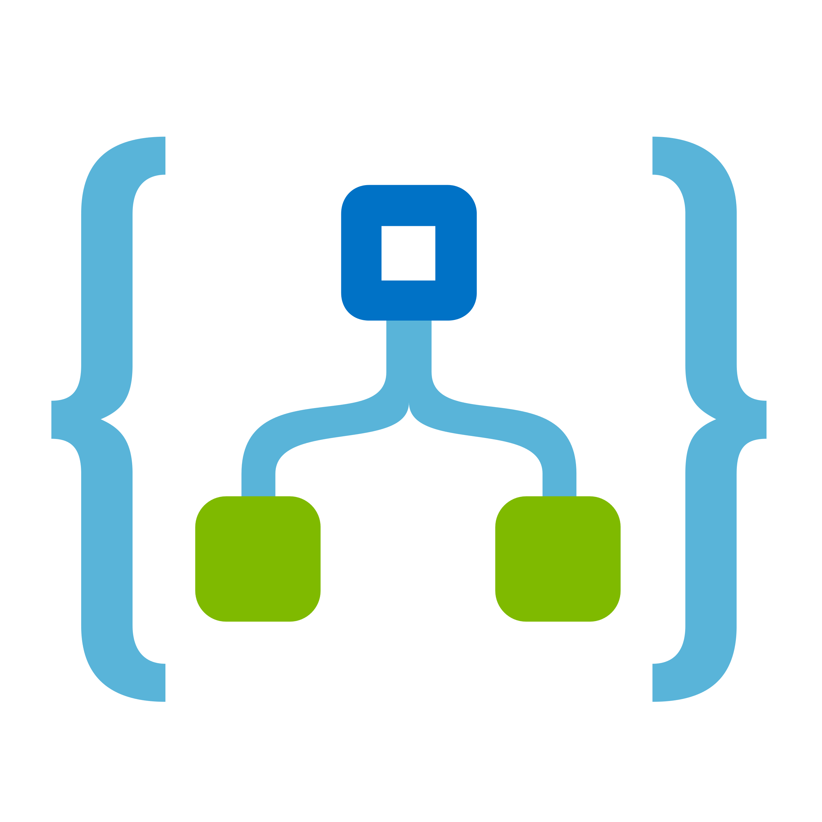
Integration as a Services (iPaaS)
Fast integrations using a visual designer
Workflow creation with triggers and actions
Connect applications, data, and services
Connect and orchestrate Azure Functions
Notes:
Logic Apps is the serverless component in Azure that enables you with a variety of integrations – from Office to Google Maps, to additional Azure services like Functions and Event Grid.

Slide 25
Azure Logic App
What’s the difference?
Microsoft Flow
Required an Azure Subscription
Comes with Office 365
Notes:
Very similar
Flow is build on top of Logic App so of course everything that is possible in Flow is also possible in Logic App

Slide 26
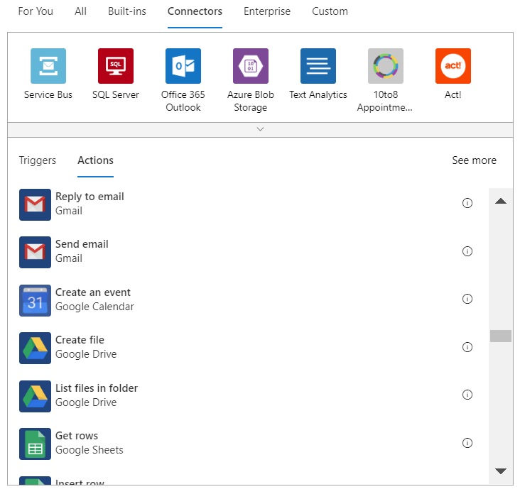
Hundreds of connectors for integrations
Notes:
Logic Apps have literally hundreds of integrations and support for custom integrations as well. You are able to integrate with Azure resources, database servers, SharePoint installations, Office 365, Dynamics, or third party resources like gmail, Twilio for text messaging or Slack for real-time communication.

Slide 27
Modernizing with Logic Apps
Demo

Slide 28
Azure Functions

Slide 29




Introducing Functions
Code
Azure Functions
Events
Notes:
The first example you saw was functions. Functions are literally code and events. And now I’ve revealed a carefully guarded secret: you know where the functions logo came from!

Slide 30
Why Azure Functions?
1
Supports C#, Node/JavaScript, Python, F#, PHP, PowerShell, Bash, Batch
2
Supports NuGet and NPM
3
Can even run EXE’s or call into DLL’s

Slide 31

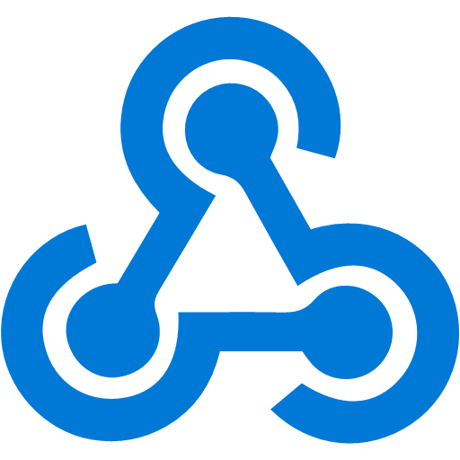
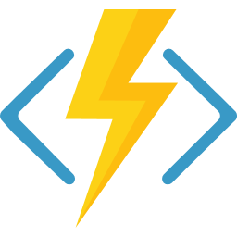



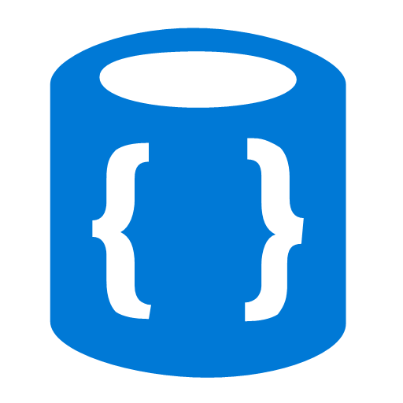

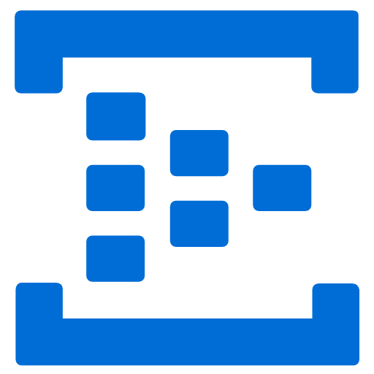
Azure Functions
Events
Code
Outputs
React to timers, HTTP, or events from your favorite Azure services, with more on the way
Author functions in C#, F#, JavaScript, TypeScript, Java, Python, PowerShell, and more
Send results to an ever-growing collection of services

Slide 32
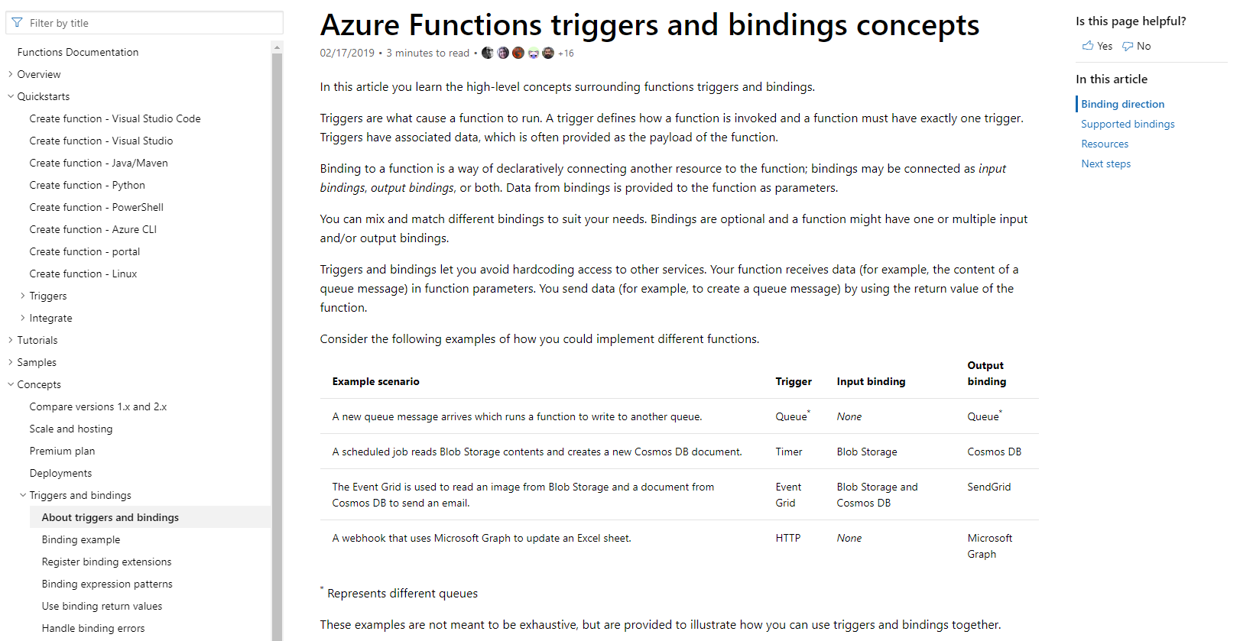
/Docs alert
Explore overviews, tutorials, samples, and more.
aka.ms/fn-triggers

Slide 33
Scenarios
Every 15 minutes
Find and clean invalid data
Clean table
File added to Blob Storage
Transform CSV to datarows
Power BI
Chart graphic
Notes:
Here are some of the scenarios we see serverless being used for. Have you ever had to find a scheduling service or install a special service just to run a job at a regular interval? You can trigger functions with a timer trigger and do things like purge expired web sessions from a table. Another common scenario is to trigger a function based on a blob storage event. For example, an ETL process may upload a CSV file that is then parsed, transformed into database rows and then analyzed with a Power BI dashboard.

Slide 34
Scenarios
Photo taken and
WebHook called
Stores in blob storage
Produces scaled images
Create ad based on user profile
Completed page
Loaded web page
r
Calls WebHook
Notes:
Another scenario might trigger from a photograph that is uploaded and this triggers code that automatically generates thumbnails. The last scenario is my personal favorite. You visit a web page, the page calls a function with your user profile and this gathers all of the data collected to deliver a personalized ad. This is why you do a web search for smart thermostat and suddenly see IoT ads everywhere you visit.

Slide 35




Broadcast translated captions in real-time
fr
Bonjour
es
Hola
Transcriptions
& Translations
ja
こんにちは
it
Ciao
de
Hallo
Hello

Slide 36
Calling an Http Triggered Function
Starting our loan application process

Slide 37
Best practices for writing serverless functions
Functions should do one thing
Functions should be quick
Functions should be stateless

Slide 38
Durable Functions
Lets you write orchestrations of multiple things
Lets you have long-running orchestrations
Has state

Slide 39
Wait, but didn’t you just say…?
Functions…
… should do one thing
… should be quick
… should be stateless
Durable Functions…
… lets you write orchestrations of multiple things
… lets you have long-running orchestrations
… has state

Slide 40




Stateful patterns in Durable Functions
Function chaining
Async HTTP APIs
Fan-out/fan-in
POST
202
Long-running monitor
Human interaction
Event aggregation
Notes:
All of these patterns can be expressed using very simple code. No manifests or schemas.
More details: https://docs.microsoft.com/en-us/azure/azure-functions/durable/durable-functions-concepts
We’ll look at function chaining and fan-out/fan-in in more detail next.

Slide 41
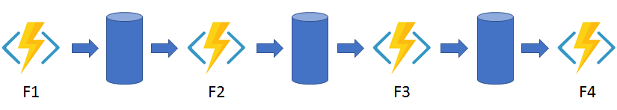
Pattern: Function chaining
public static async Task<object> Run(DurableOrchestrationContext context)
{
try
{
var x = await context.CallActivityAsync<object>("F1");
var y = await context.CallActivityAsync<object>("F2", x);
var z = await context.CallActivityAsync<object>("F3", y);
return await context.CallActivityAsync<object>("F4", z);
}
catch (Exception)
{
// Error handling or compensation goes here.
}
}
Notes:
In the function chaining pattern, a sequence of functions executes in a specific order. In this pattern, the output of one function is applied to the input of another function.

Slide 42
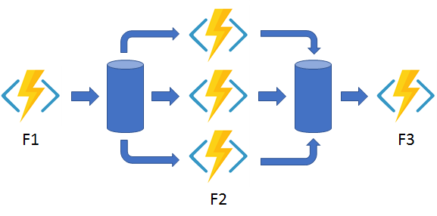
Pattern: Fan out & fan in
public static async Task Run(DurableOrchestrationContext context)
{
var parallelTasks = new List<Task<int>>();
// Get a list of N work items to process in parallel.
object[] workBatch = await context.CallActivityAsync<object[]>("F1");
for (int i = 0; i < workBatch.Length; i++)
{
Task<int> task = context.CallActivityAsync<int>("F2", workBatch[i]);
parallelTasks.Add(task);
}
await Task.WhenAll(parallelTasks);
// Aggregate all N outputs and send the result to F3.
int sum = parallelTasks.Sum(t => t.Result);
await context.CallActivityAsync("F3", sum);
}
Notes:
In the fan out/fan in pattern, you execute multiple functions in parallel and then wait for all functions to finish. Often, some aggregation work is done on the results that are returned from the functions.

Slide 43
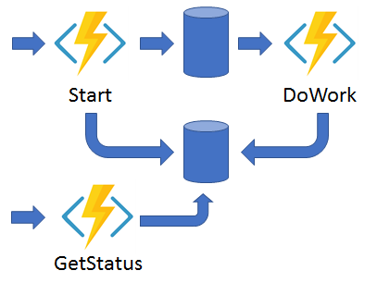
Pattern: Asynchronous HTTP APIs
// An HTTP-triggered function starts a new orchestrator function instance.
public static async Task<HttpResponseMessage> Run(
HttpRequestMessage req,
DurableOrchestrationClient starter,
string functionName,
ILogger log)
{
// The function name comes from the request URL.
// The function input comes from the request content.
dynamic eventData = await req.Content.ReadAsAsync<object>();
string instanceId = await starter.StartNewAsync(functionName, eventData);
log.LogInformation($"Started orchestration with ID = '{instanceId}'.");
return starter.CreateCheckStatusResponse(req, instanceId);
}
Notes:
The async HTTP APIs pattern addresses the problem of coordinating the state of long-running operations with external clients. A common way to implement this pattern is by having an HTTP call trigger the long-running action. Then, redirect the client to a status endpoint that the client polls to learn when the operation is finished.

Slide 44
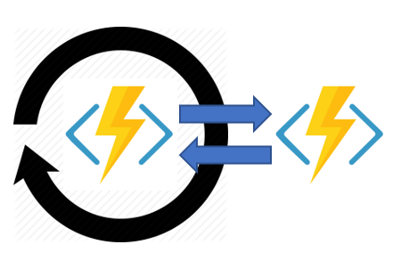
Pattern: Monitor
public static async Task Run(DurableOrchestrationContext context)
{
int jobId = context.GetInput<int>();
int pollingInterval = GetPollingInterval();
DateTime expiryTime = GetExpiryTime();
while (context.CurrentUtcDateTime < expiryTime)
{
var jobStatus = await context.CallActivityAsync<string>("GetJobStatus", jobId);
if (jobStatus == "Completed")
{
// Perform an action when a condition is met.
await context.CallActivityAsync("SendAlert", machineId);
break;
}
// Orchestration sleeps until this time.
var nextCheck = context.CurrentUtcDateTime.AddSeconds(pollingInterval);
await context.CreateTimer(nextCheck, CancellationToken.None);
}
// Perform more work here, or let the orchestration end.
}
Notes:
The monitor pattern refers to a flexible, recurring process in a workflow. An example is polling until specific conditions are met. You can use a regular timer trigger to address a basic scenario, such as a periodic cleanup job, but its interval is static and managing instance lifetimes becomes complex. You can use Durable Functions to create flexible recurrence intervals, manage task lifetimes, and create multiple monitor processes from a single orchestration.

Slide 45
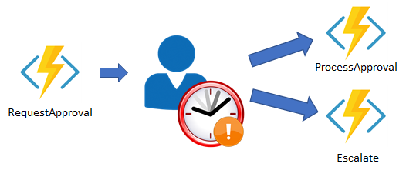
Pattern: Human interaction
public static async Task Run(DurableOrchestrationContext context)
{
await context.CallActivityAsync("RequestApproval");
using (var timeoutCts = new CancellationTokenSource())
{
DateTime dueTime = context.CurrentUtcDateTime.AddHours(72);
Task durableTimeout = context.CreateTimer(dueTime, timeoutCts.Token);
Task<bool> approvalEvent = context.WaitForExternalEvent<bool>("ApprovalEvent");
if (approvalEvent == await Task.WhenAny(approvalEvent, durableTimeout))
{
timeoutCts.Cancel();
await context.CallActivityAsync("ProcessApproval", approvalEvent.Result);
}
else
{
await context.CallActivityAsync("Escalate");
}
}
}
Notes:
Many automated processes involve some kind of human interaction. Involving humans in an automated process is tricky because people aren't as highly available and as responsive as cloud services. An automated process might allow for this by using timeouts and compensation logic.

Slide 46
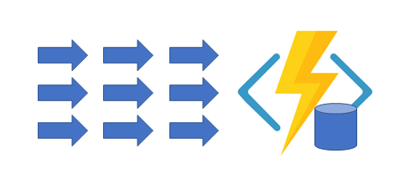
New pattern: External event aggregation
public static async Task Counter([EntityTrigger(EntityClassName = "Counter")] IDurableEntityContext ctx)
{
int currentValue = ctx.GetState<int>();
int operand = ctx.GetInput<int>();
switch (ctx.OperationName)
{
case "add":
currentValue += operand;
break;
case "subtract":
currentValue -= operand;
break;
case "reset":
await SendResetNotificationAsync();
currentValue = 0;
break;
}
ctx.SetState(currentValue);
}
Notes:
The sixth pattern is about aggregating event data over a period of time into a single, addressable entity. In this pattern, the data being aggregated may come from multiple sources, may be delivered in batches, or may be scattered over long-periods of time. The aggregator might need to take action on event data as it arrives, and external clients may need to query the aggregated data.

Slide 47
Loan Processing Workflow
Running the loan-application process

Slide 48
Enterprise Serverless
Premium Functions Plan
VNet Support
No cold start
Max/Min Instance Scaling Provisions
Crazy New Stuff
Logic Apps VNet Support
Custom Container Support
KEDA and Kubernetes Orchestration

Slide 49
serverless

Slide 50
serverless
microservices

Slide 51
microservices

Slide 52
Microservices: for faster app development
Monolithic
Microservices
Large, all-inclusive app
Small, independent services
Independent deployments
Improved scale and resource utilization per service
Smaller, focused teams
App
App
App
Notes:
Briefly explain the software trend to microservices for faster app development
With the move to the cloud over the last few years, the industry has embraced an architectural pattern for building cloud-scale, reliable services.
Microservices are Independent, immutable deployments within containers
Small scalable services for improved resource utilization
Teams can focus on their own service without affecting other, use their own tools/stack
.NET Core was built for the cloud and is well suited for this type of development

Slide 53
ASP.NET Core 3.0
gRPC
High performance contract-based RPC services with .NET
Works across many languages and platforms
Worker Service
Starting point for long running back processes like Windows Server or Linux daemon
Producing or consuming messages from a message queue
Web API’s + Identity
Swagger + Client generation
Add security and authentication to Web API’s
Notes:
We’ve added a ton of features to ASP.NET Core in version 3.0 on order to make building resilient microservices easier.

Slide 54
Why Containers?
What is this whole manifesto and why should I care?

Slide 55
What are containers
A container is a standard unit of software that packages up code and all its dependencies so the application runs quickly and reliably from one computing environment to another.
It includes everything needed to run the application: code, runtime, system tools and libraries as well as settings.
Multiple containers are run by a single OS kernel, therefore are more lightweight than virtual machines.
Notes:
Containers offer a logical packaging mechanism in which applications can be abstracted from the environment in which they actually run.
This decoupling allows container-based applications to be deployed easily and consistently, regardless of the target environment
Containerization provides a clean separation of concerns – isolation.
Developers focus on their application logic and dependencies; IT Ops focus on deployment and management.

Slide 56

Why Containers
Works on my machine
Every environment looks the same
Increased velocity
Run anywhere
Notes:
Containers give developers the ability to create predictable environments, isolated from other applications.
Every dependency needed by the application, versions of the runtime, libraries etc., are included in the container and guaranteed to be consistent regardless of where the image is deployed
This equals productivity. Developers and Ops teams spend less cycles debugging or diagnosing environment issues and more time pushing features and enhancements to the users.

Slide 57
Containers run everywhere
Linux
Windows
Cloud
Drones, Raspberry PI, IoT
Notes:
Containers run anywhere, easing the development and deployment of applications. Windows, Mac, Linux, datacenters, cloud and even IoT.
The widespread popularity of the Docker image format for containers helps with the portability. Wherever you want to run your software, you can likely use containers.

Slide 58
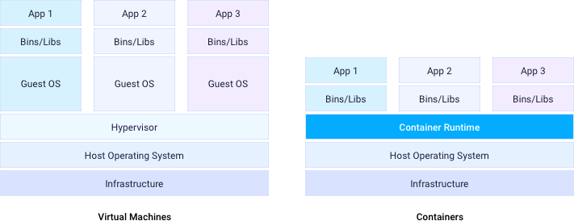
Docker Containers
Containers vs Virtual Machines
Virtual Machines
Shared host OS kernel
Portability
Faster scalability
Separate OS per instance
Large footprint
Slower startup
Notes:
Within each virtual machine runs a unique guest operating system.
VMs with different operating systems can run on the same physical server—a UNIX VM can sit alongside a Linux VM, and so on.
Each VM has its own binaries, libraries, and applications that it services, and the VM may be many gigabytes in size.
Containers sit on top of a physical server and its host OS—for example, Linux or Windows.
Each container shares the host OS kernel and, usually, the binaries and libraries, too.
Shared components are read-only. Containers are thus exceptionally “light”—they are only megabytes in size and take just seconds to start,
versus gigabytes and minutes for a VM.
Virtual machines and containers differ in several ways, but the primary difference is that containers provide a way to virtualize an OS so that multiple workloads can run on a single OS instance.
With VMs, the hardware is being virtualized to run multiple OS instances.

Slide 59
Dockerfile Example
Dockerfile
FROM mcr.microsoft.com/dotnet/core/sdk:3.0
ENV ASPNETCORE_ENVIRONMENT=Development
WORKDIR /app
COPY . .
RUN dotnet restore
ENTRYPOINT[“dotnet”,”run”]
Run: docker build –t spboyer/ignite-afun60 .
to build the docker image
Notes:
Here is basic example of a Dockerfile, it uses the base image for .NET Core 3.0 which in this case is based on Debian
Setting an ENVIRONMENT variable
Setting a working directory of “app”
Copying the source files there
Restoring the package dependencies and then running the command “dotnet run”
This Dockerfile is a template for the application to be built into an image run anywhere containers are supported.

Slide 60
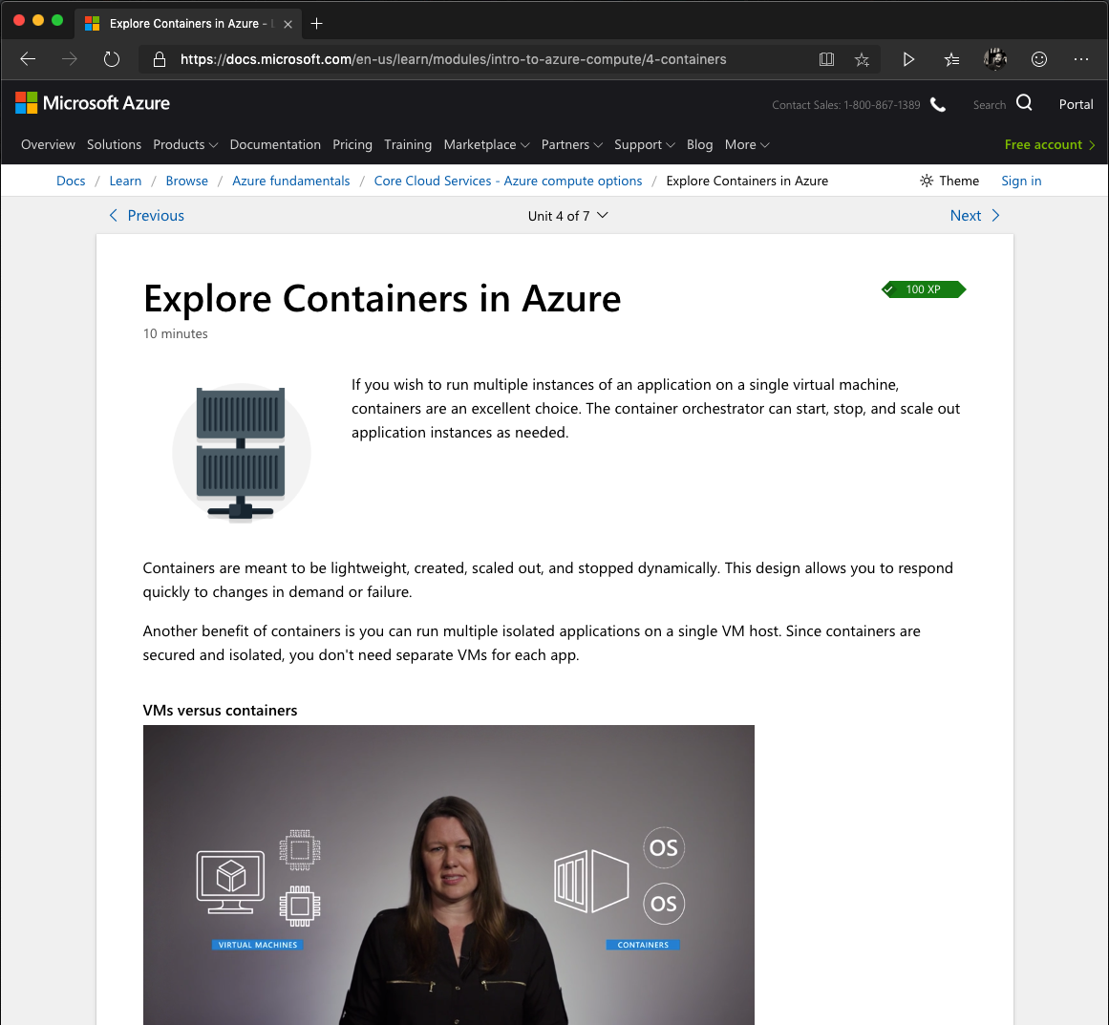
Microsoft Learn – Explore Containers in Azure
aka.ms/AFUN60MSLearnCollection
Containers are lightweight, scalable and immutable
Containers run multiple isolated apps on a single host
Virtual Machines run a single OS
VMs startup times longer vs Containers

Slide 61
Azure Container Instances (ACI)
Notes:
shell.azure.com

Slide 62
What is Azure Container Instances (ACI)?
Run Containers with a single command
Per-second Billing
No virtual machine management
Notes:
You can start a container using a single command. This command can be run on the command line, Azure DevOps, LogicApps; many options.
Per second billing, Only be charged for the time the container is running.
Just run the container, there is no infrastructure to manage.

Slide 63
Create an instance using the Azure CLI
Azure CLI
$ az group create --name myResourceGroup --location eastus
$ az container create -n mycontainer --image spboyer/ignite-afun60 -g myResourceGroup --ip-address public
Create a resource group
az container create : creates instance of container
Notes:
-n is the shorthand for --name, as is –g for --resource-group
Creating an instance is easy in single command. Well in this case, 2 commands because we must create a resource group ( a logical grouping of assets or objects)
The ip-address option is set to public so the instance is available externally.

Slide 64
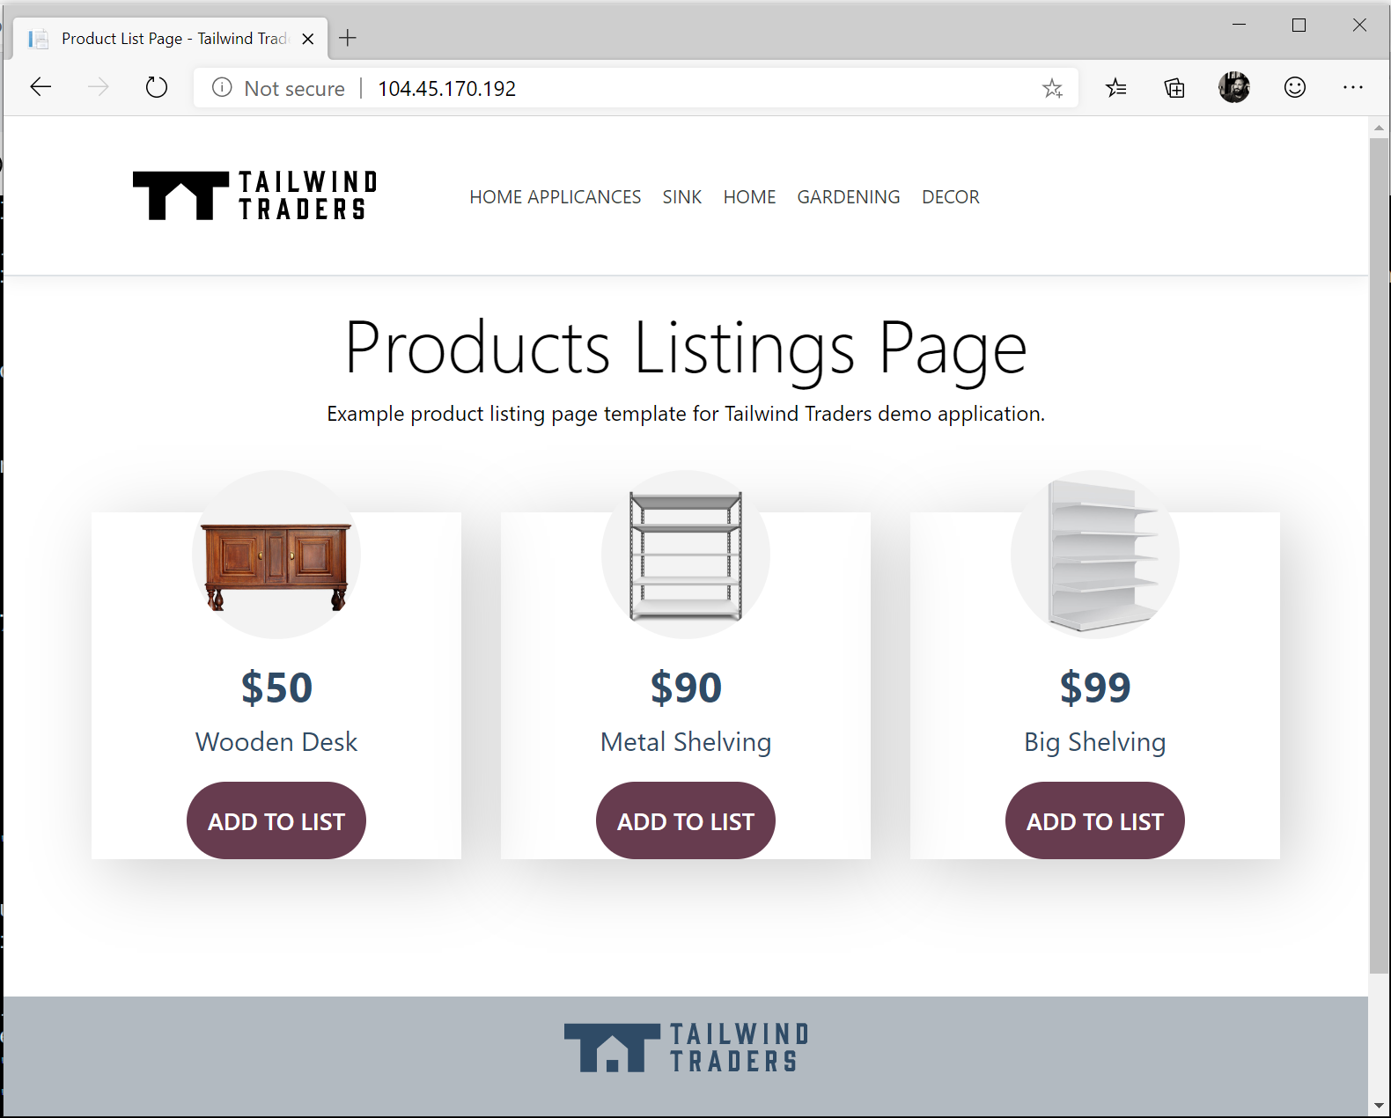
Running Container Image
az container create
"ipAddress": {
"ip": "52.151.224.173",
"ports": [
{
"port": 80,
"protocol": "TCP"
}
]
},
"location": "eastus",
"name": "mycontainer",
"osType": "Linux",
"provisioningState": "Succeeded",
Notes:
Once the container Is created, the output (snippet here) contains a lot of information but the important piece is the IP which we can either use curl to get the results or
Open browser to view the results.

Slide 65
What are the use cases for ACI?

Slide 66
What can you build with Azure Container Instances?
Data processing jobs
Event-driven applications with Azure Logic Apps
Virtual nodes, elasticity for Kubernetes on AKS
Notes:
Have you ever had that server or machine that just existed to run those console apps on the windows scheduler? Every Monday at 10 am it would run myjob.exe – Now put that app in a container, and run it in the cloud and oly be charged when it runs.
Data processing apps, Reporting, CI Jobs, are all good options. Using ACI in place of VM reduces footprint as well as costs.
ACI also provides fast, isolated compute to handle spikes without managing servers. Through the use of Virtual Kubelet, your AKS cluster is enabled to scale and provision pods in seconds with just enough capacity to handle the load.

Slide 67
Advanced Features of Azure Container Instances
Container groups
Manage state with Azure file shares
Deploy from Azure Container Registry portal
Notes:
Azure Container Instances supports the deployment of multiple containers onto a single host using a container group
A container group is useful when building an application sidecar for logging, monitoring, or any other configuration where a service needs a second attached process.
By default, Azure Container Instances are stateless. If the container crashes or stops, all of its state is lost. To persist state beyond the lifetime of the container, you must mount a volume from an external store.

Slide 68

Limitations of Azure Container Instances
Zero-downtime upgrades
Batch workflows
Service discovery
Integrated load balancing
Auto-scaling
Notes:
If you need these features, you probably need an orchestrator – see Kubernetes via AKS

Slide 69
Azure Container Instances (ACI)
Demo
Notes:
No time for demo, not needed.

Slide 70
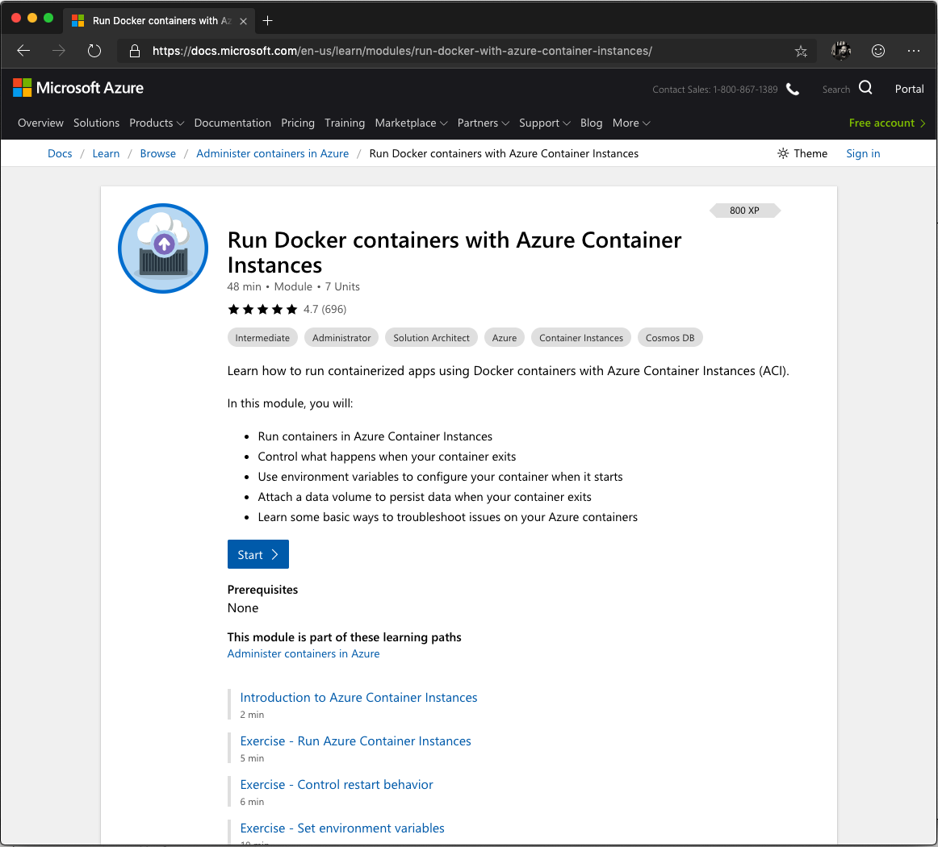
Microsoft Learn – Azure Container Instances
aka.ms/AFUN60MSLearnCollection
Run containers in ACI
Control what happens when your container exits
Use environment variables to configure your container when it starts
Attach a data volume to persist data when your container exits
Learn some basic ways to troubleshoot issues on your Azure containers

Slide 71
Azure Container Registry (ACR)

Slide 72
What is a container registry?
A repository for storing container images
Public registries i.e. Docker Hub – free & easy
Private registries allow for efficient/secure storage
Notes:
How does it help in building, shipping and running an application? Why might an organization need a private registry to securely and efficiently manage their container images? All good questions. A good analogy is GitHub or code repositories.
The container is a snapshot of your application and its dependencies. Once the image is created, the registry is a place to hold this application template. A registry is a way to share the application between systems. Docker Hub is a public registry available and easy to use via the internet. However, as with our code, their may be restrictions the prohibit us from storing these images outside of our domain, country, etc. For instance, Intellectual Property (IP) or sensitive data restrictions are most common.
A private registry allows for your organization to setup RBAC (Role based Access Control) to the registry based on LDAP or AD already setup within your organization to enforce rules such as push, pull access.

Slide 73
Azure Container Registry (ACR)
Manage a Docker private registry as a first-class Azure resource

Slide 74
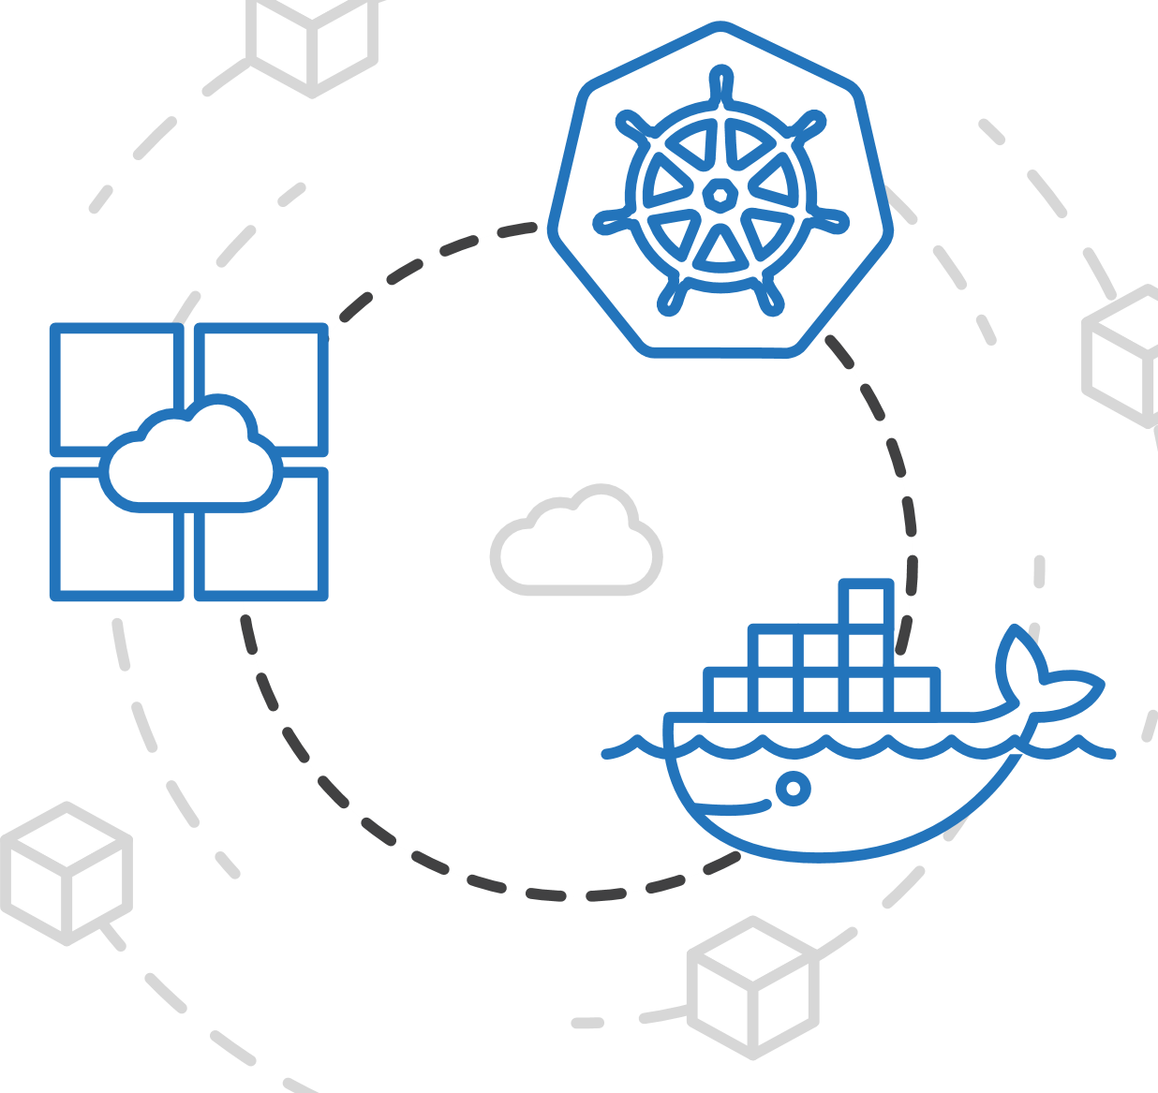
Azure Container Registry (ACR)
Manage a Docker private registry as a first-class Azure resource
Manage images for all types of containers
Notes:
ACR allows you to store images for all types of container deployments. Mesosphere, Docker Swarm, Kubernetes, and Azure services. You or your DevOps team can seamlessly integrate the build and deploy process with ACR.

Slide 75
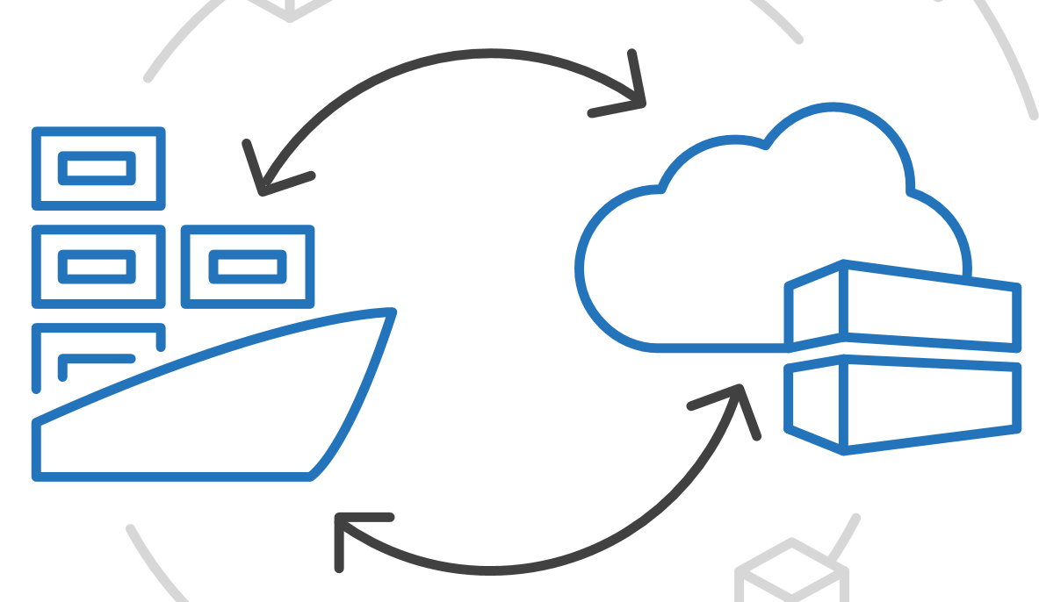
Azure Container Registry (ACR)
Manage a Docker private registry as a first-class Azure resource
Manage images for all types of containers
Use familiar, open-source Docker CLI tools
Notes:
Docker’s command line interface works directly with ACR using the login, push, pull commands just as you would with Docker Hub.
No new APIs or commands to learn.

Slide 76
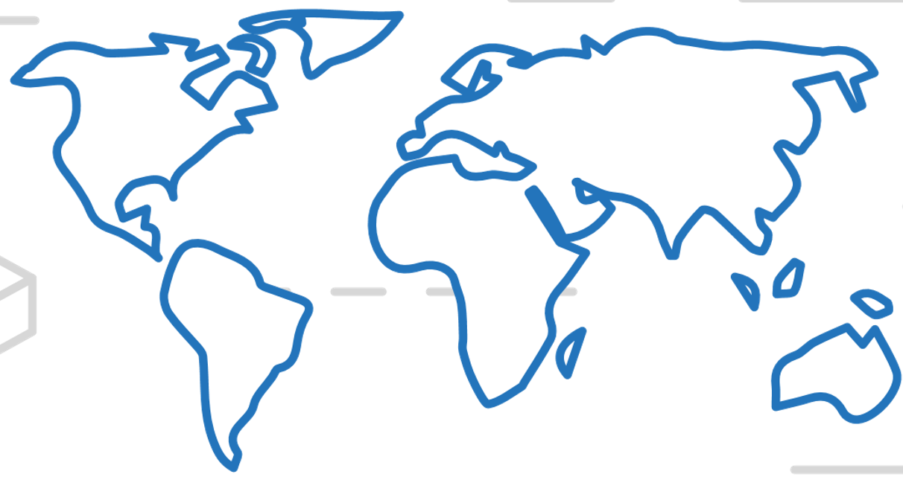
Azure Container Registry (ACR)
Manage a Docker private registry as a first-class Azure resource
Manage images for all types of containers
Use familiar, open-source Docker CLI tools
Azure Container Registry geo-replication
Notes:
Efficiently manage a single registry replicated across multiple regions. Geo-replication enables you to manage global deployments as one entity to simplify operations and management.
Reduce the network latency and eliminate any ingress/egress charges by keeping your registry in the same data center as your deployments. ACR gives you local, network-close storage of your container images and full control
over naming and organization of the images.

Slide 77
Azure Container Registry (ACR)
Create a container registry in the portal quickly

Slide 78
Azure Container Registry
Azure CLI : Create ACR
$ az acr create --resource-group myResourceGroup --name myContainerRegistry
--sku Basic
Using the Azure Command Line tool
Single command to create a private registry
Notes:
This is a simple BASIC registry, a cost optimized option. Good for getting started, more options in SKUs for global replication etc for Production.

Slide 79
Commands
ACR Commands
$ az acr login –n myacr
$ docker pull myacr.azurecr.io/hello-world
$ docker push myacr.azurecr.io/hello-world
$ docker rmi myacr.azurecr.io/hello-world
Logging into the registry
Standard Docker commands
Push, Pull, Removing images

Slide 80

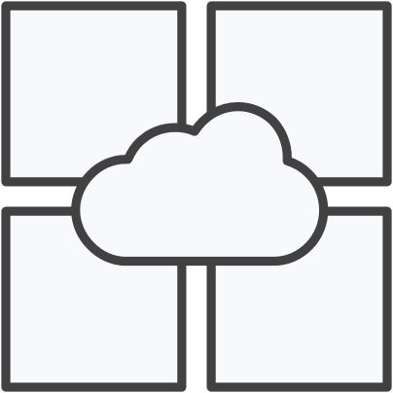

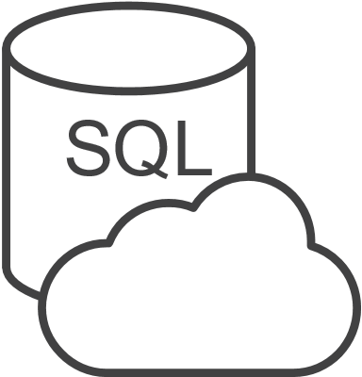

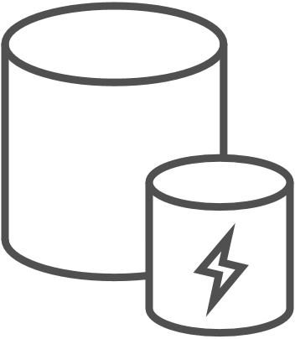
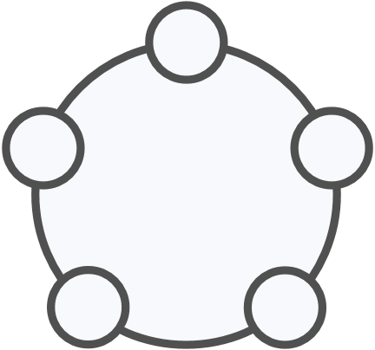
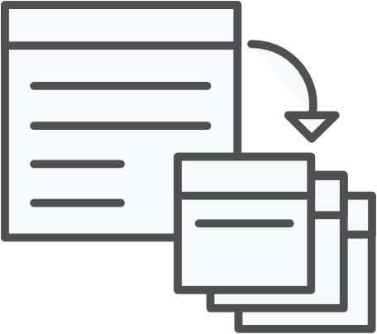


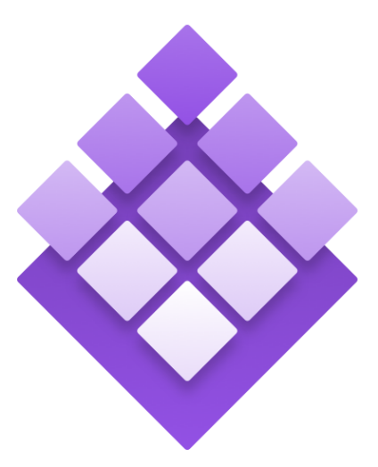
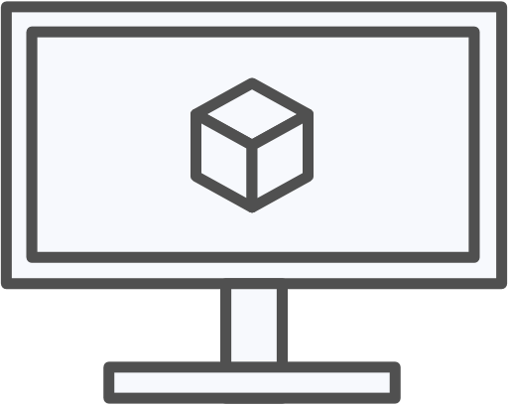
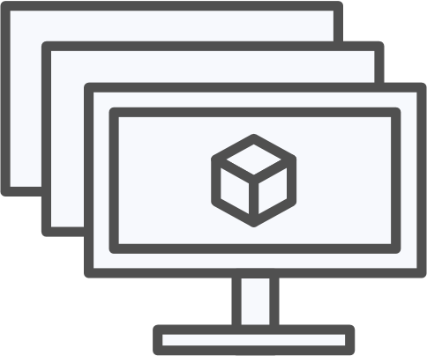
Azure Container Registry
OSBA
App Service
Azure Container Registry (ACR)
Partner services
Azure services
PaaS
OpenShift
SQL Database
Azure Container Service (AKS)
Service Fabric
Batch
Pivotal Cloud Foundry
Redis Cache
ACS Engine
Docker Enterprise Edition
CosmosDB
Virtual Kubelet
Mesosphere DC/OS
And more!
Azure Container Instances (ACI)
Azure Virtual Machines
Virtual Machine Scale Sets (VMSS)
Azure
IaaS
Notes:
The Azure Container Registry is positioned close to all of your other Azure objects, VMs, Kubernetes clusters in AKS, AppService, ACI as discussed previously. Therefore when pulling the image for your applications to these resources, the latency is greatly reduced.
This is benefit for scaling, CI/CD for builds and deployments and so forth.
Using public repositories such as Docker Hub or even GitHub; the ingress/egress costs are incurred leaving Azure plus the network latency going outside of this infrastructure.

Slide 81
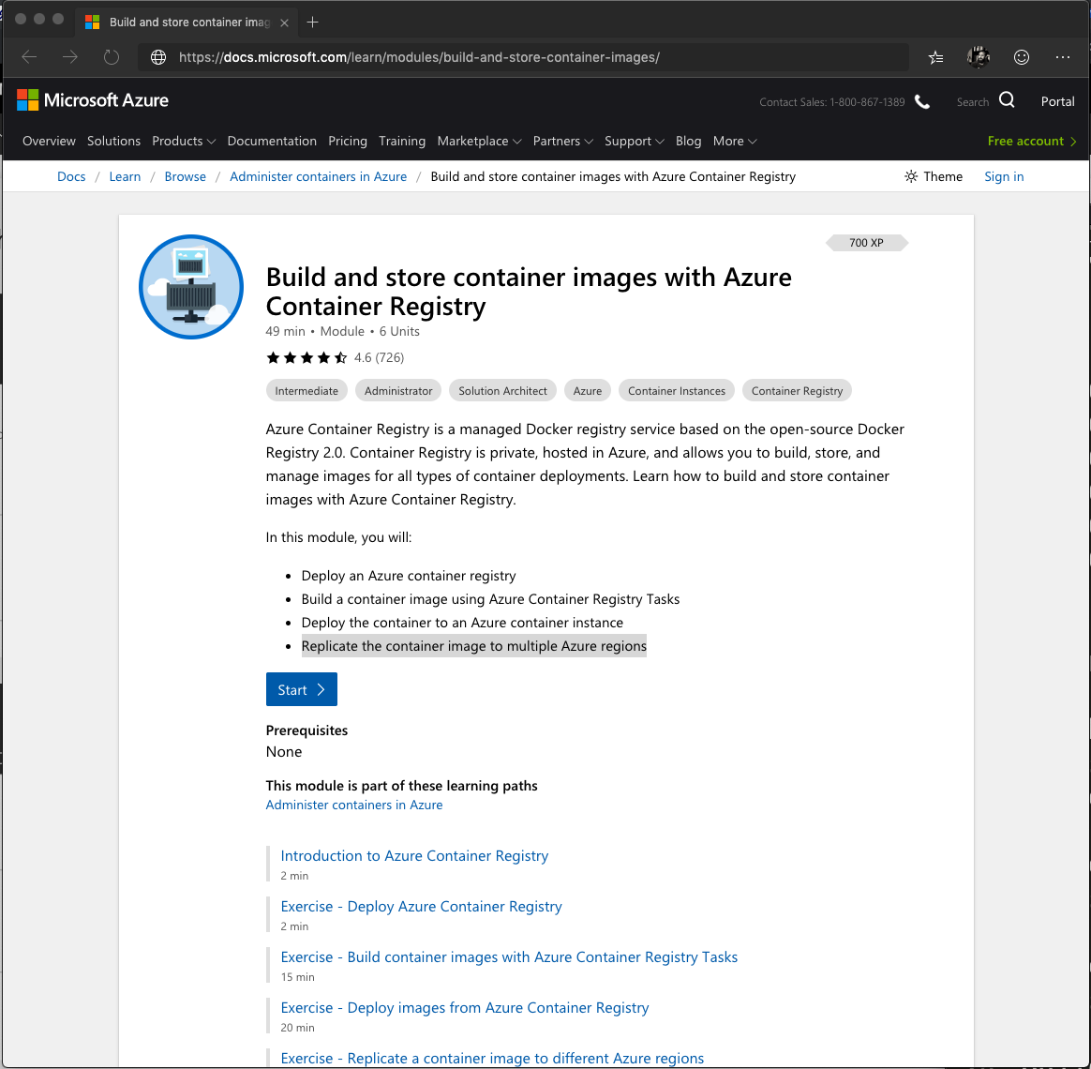
Microsoft Learn – Azure Container Registry
aka.ms/AFUN60MSLearnCollection
Deploy an Azure container registry
Build a container image using Azure Container Registry Tasks
Deploy the container to an Azure container instance
Replicate the container image to multiple Azure regions

Slide 82
Azure App Service

Slide 83
Azure App Service
Multiple languages and frameworks
Scalability and high availability
DevOps optimization, security, and compliance
Templates, IDE integration, serverless and much more…
Notes:
Azure App Service is an HTTP-based service for hosting web applications, REST APIs, and mobile back ends. You can develop in your favorite language, be it .NET, .NET Core, Java, Ruby, Node.js, PHP, or Python. Applications run and scale with ease on both Windows and Linux-based environments.
Deploy Apps from GitHub, Azure DevOps, even DropBox! App Service offers just about every piece you’d need to run a scalable, secure web application.
Speak to slot deployments, scalability points, and that is is the basis for serverless apps too.

Slide 84

Azure App Service
Fully managed compute platform
Optimized for hosting websites and web apps
Windows and Linux natively or Containers
Options for very high scale, isolated environments
Notes:
App Service is a fully managed compute platform that is optimized for hosting websites and web applications.
Customers can use App Service on Linux to host web apps natively on Linux for supported application stacks.
Node, Java, PHP, Python, .NET Core, Ruby can all be run natively or within containers.

Slide 85
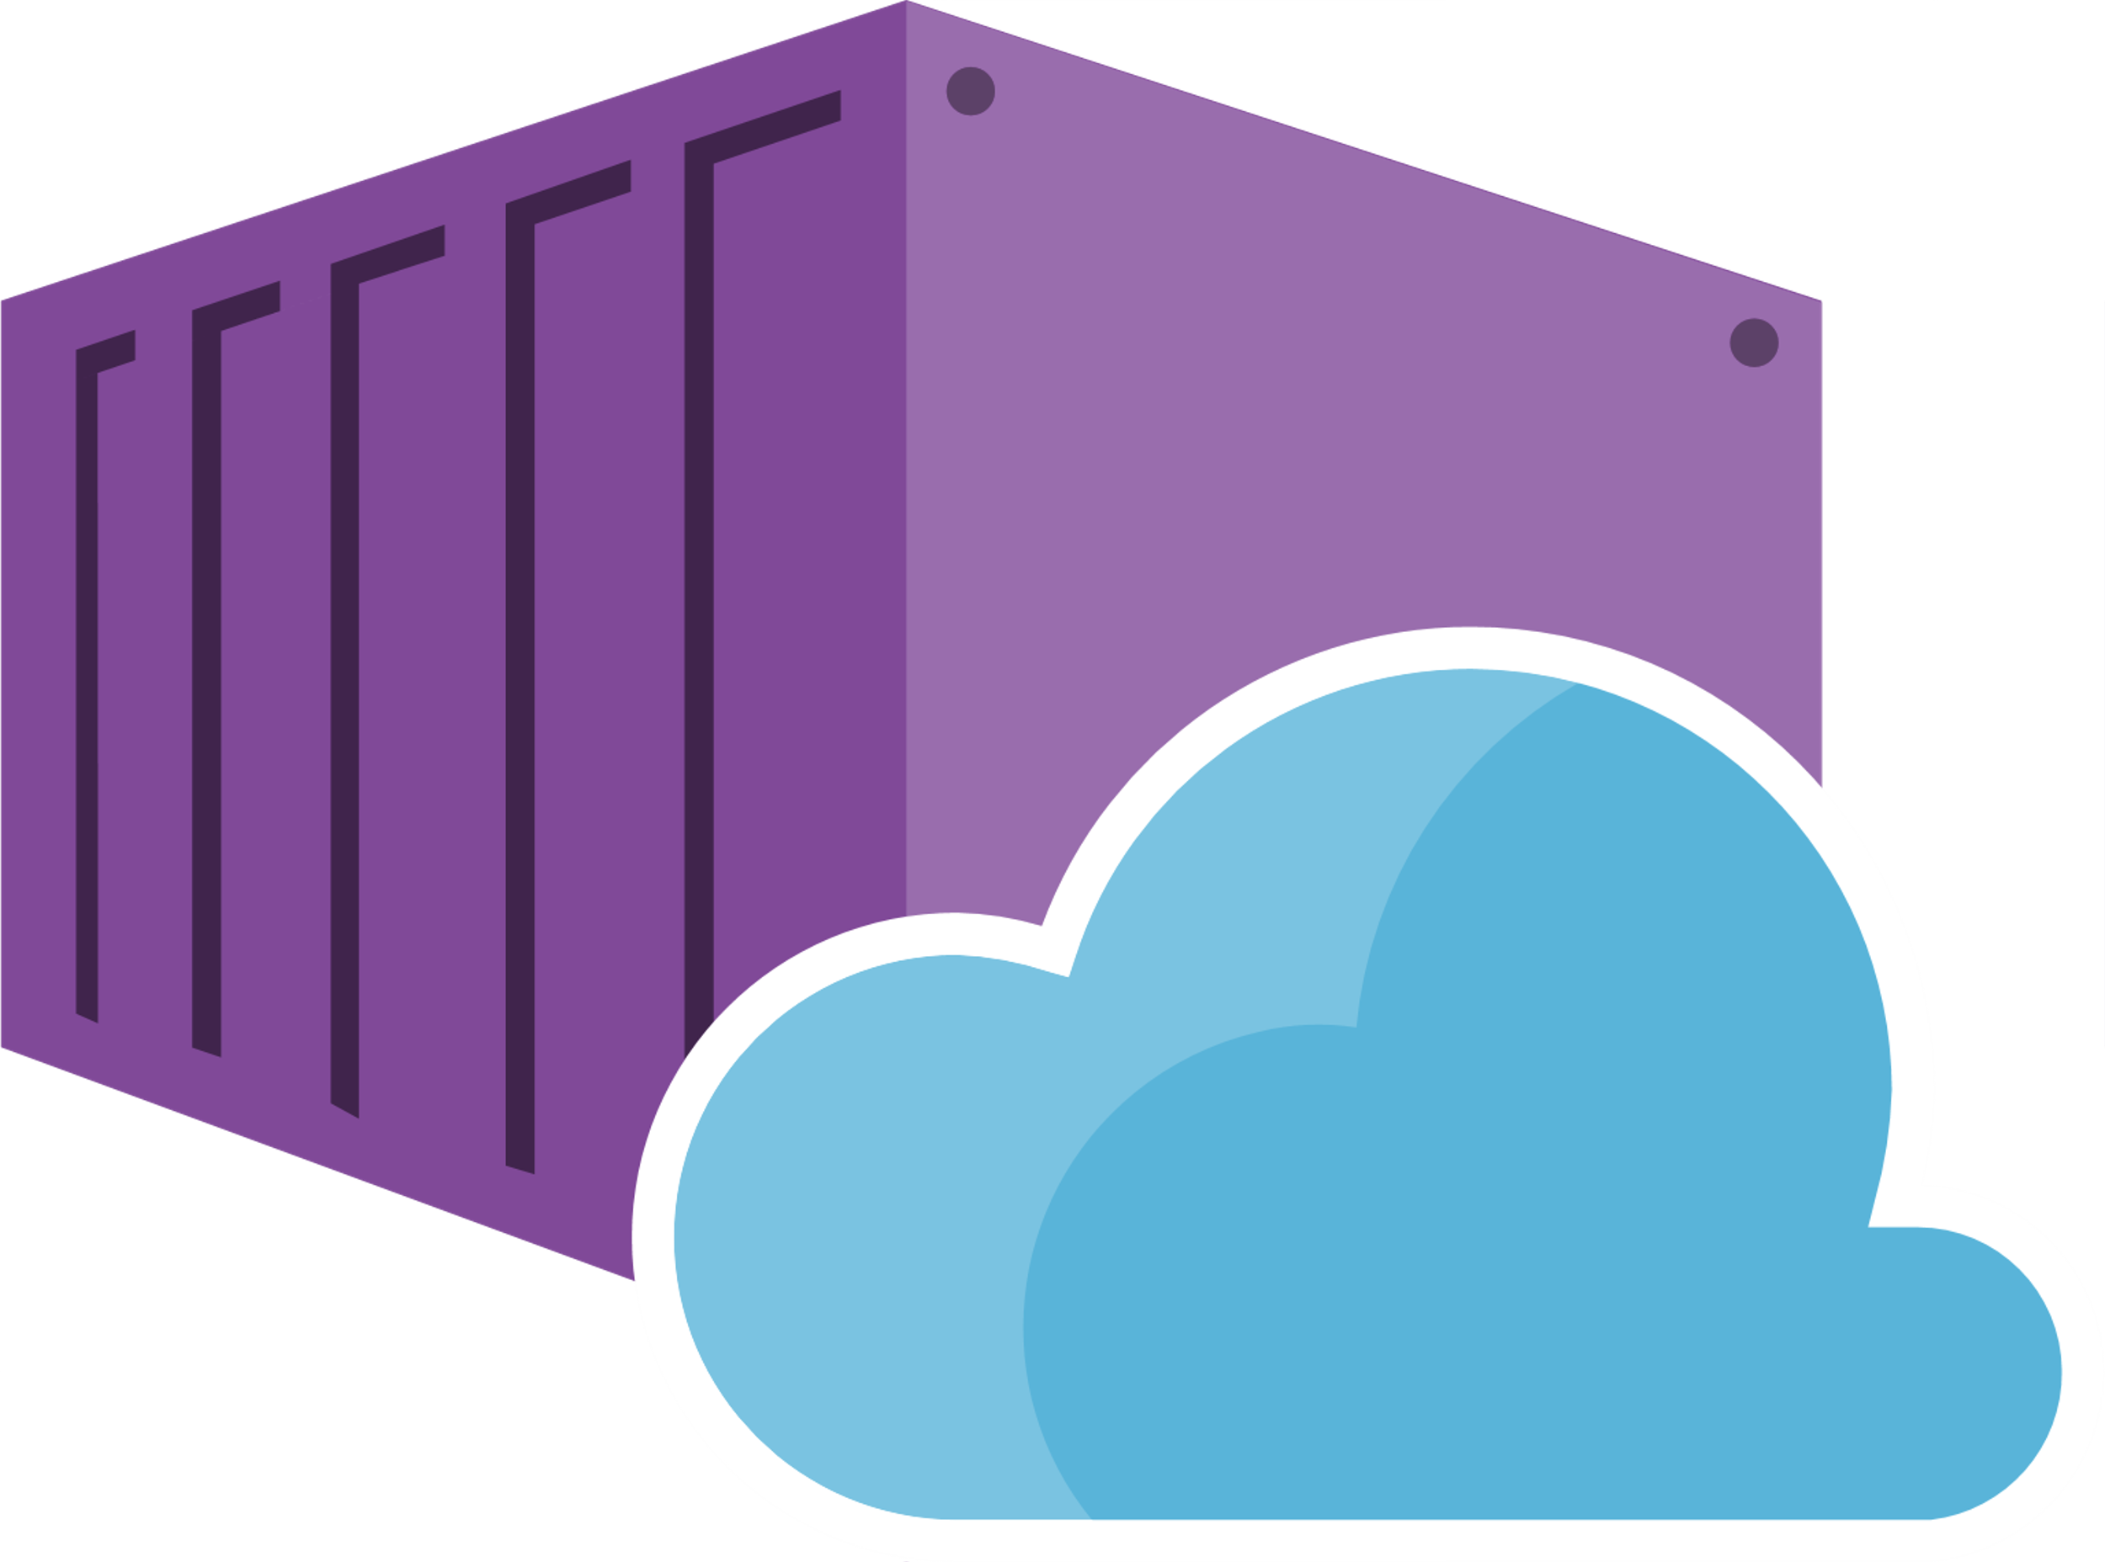
Web App for Containers
Easily deploy and run and containerized apps
Take advantage of built-in auto scaling and load balancing
Streamline CI/CD with Docker Hub, Azure Container Registry, and GitHub
Notes:
Just pull container images from Docker Hub or a private Azure Container Registry, and Web App for Containers will deploy the containerized app with your preferred dependencies to production in seconds.
Simplify your container image deployments through CI/CD) capabilities with Docker Hub, Azure Container Registry, and DevOps. App Service creates an association with the selected repository, so your apps are updated each time your source code changes.
Scaling based on load; CPU, RAM etc. Load balancing is handled, Can be overridden manually with CLI or in the portal.

Slide 86
Azure App Service
Demo

Slide 87
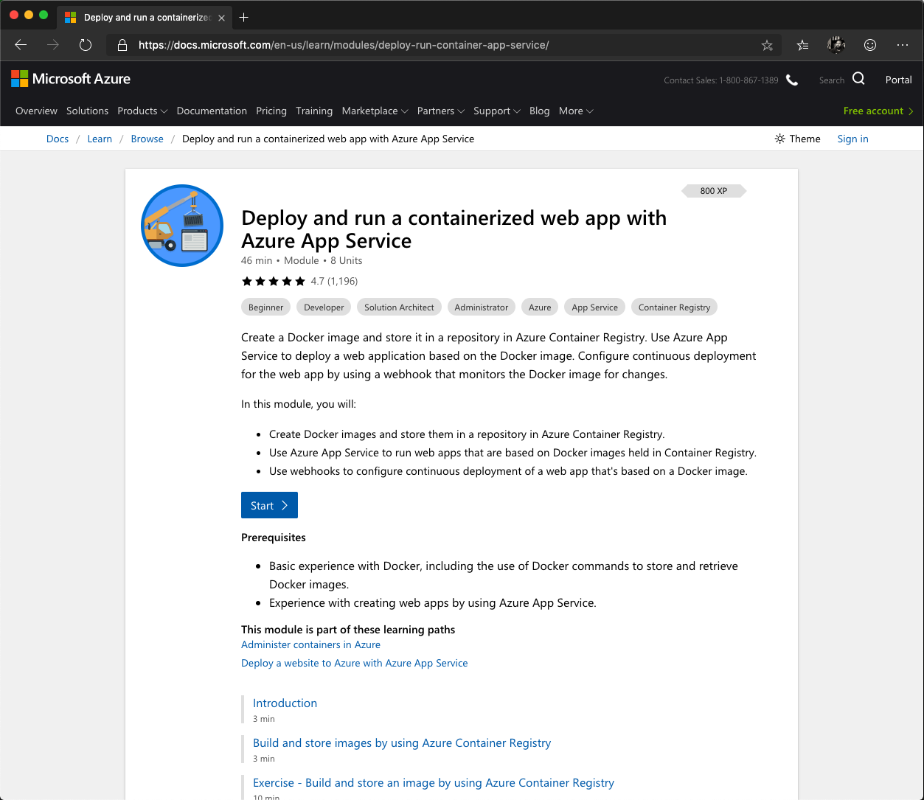
Microsoft Learn – Azure App Service
aka.ms/AFUN60MSLearnCollection
Deploy and run a containerized web application with Azure App Service
Create Docker images and store them in a repository in Azure Container Registry.
Use webhooks to configure continuous deployment of a web app that's based on a Docker image.

Slide 88
Azure Kubernetes Service (AKS)

Slide 89
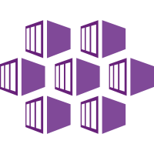
Azure Kubernetes Service (AKS)
Fully managed Kubernetes service
Elastic provisioning
Fast end-to-end development
Identity and access management with AD
Orchestration across 29 regions, Azure stack, IoT
Notes:
The fully managed Azure Kubernetes Service (AKS) makes deploying and managing containerized applications easy. It offers serverless Kubernetes, an integrated continuous integration and
continuous delivery (CI/CD) experience, and enterprise-grade security and governance.
single platform to rapidly build, deliver, and scale applications with confidence.

Slide 90
Azure Kubernetes Service (AKS)
The elements of orchestration
Scheduling
Affinity/anti-affinity
Health monitoring
Failover
Scaling
Networking
Service discovery
Coordinated app upgrades

Slide 91
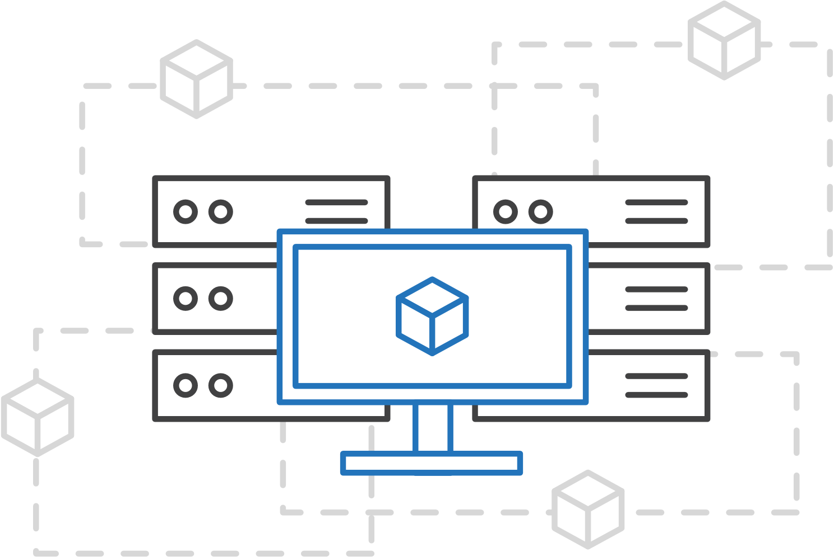
Azure Kubernetes Service (AKS)
Simplify Kubernetes deployment, management, and operations
Focus on your containers, not infrastructure
Notes:
Easily provision clusters using the CLI or infrastructure-as-code tools such as Terraform. Minimize infrastructure maintenance using automated upgrades, repair, monitoring, and scaling.
Elastically provision additional compute capacity in serverless Kubernetes in seconds without worrying about managing the infrastructure.

Slide 92
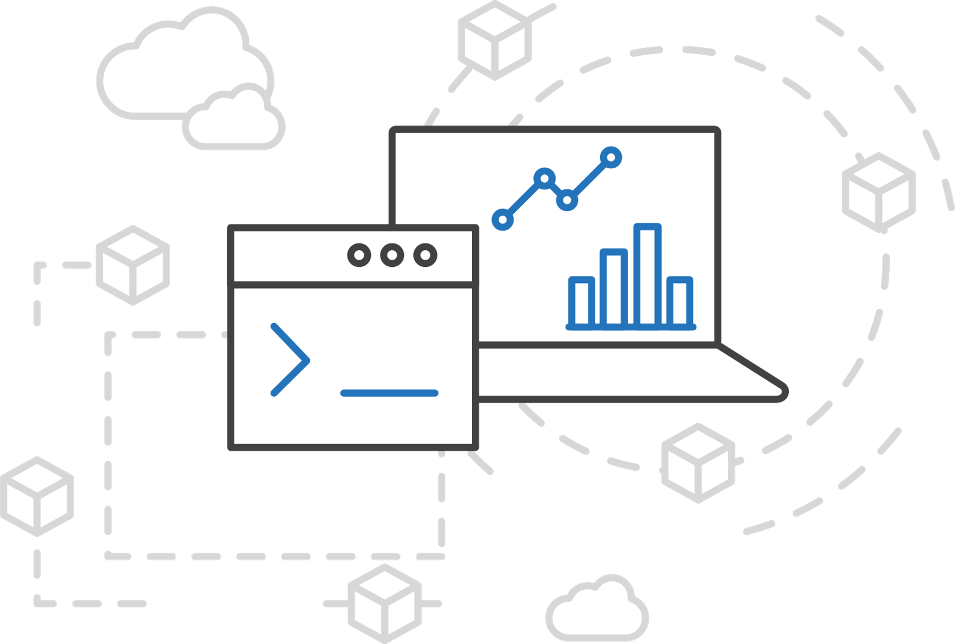
Azure Kubernetes Service (AKS)
Simplify Kubernetes deployment, management, and operations
Focus on your containers, not infrastructure
Work how you want with open-source APIs
Notes:
Easily provision clusters using the CLI or infrastructure-as-code tools such as Terraform. Minimize infrastructure maintenance using automated upgrades, repair, monitoring, and scaling.
Elastically provision additional compute capacity in serverless Kubernetes in seconds without worrying about managing the infrastructure.

Slide 93
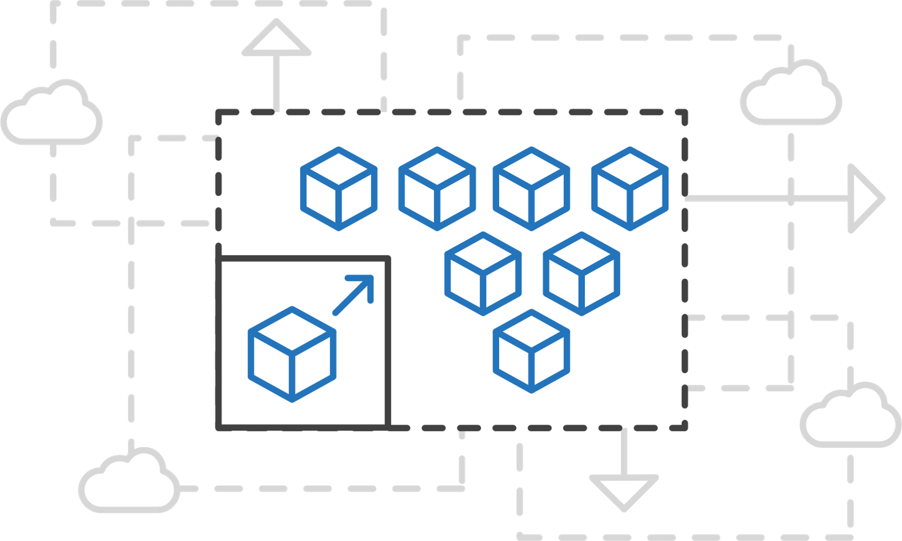
Azure Kubernetes Service (AKS)
Simplify Kubernetes deployment, management, and operations
Focus on your containers, not infrastructure
Work how you want with open-source APIs
Scale and run applications with confidence
Notes:
Easily provision clusters using the CLI or infrastructure-as-code tools such as Terraform. Minimize infrastructure maintenance using automated upgrades, repair, monitoring, and scaling.
Elastically provision additional compute capacity in serverless Kubernetes in seconds without worrying about managing the infrastructure.

Slide 94
Get Started Easily
$ az aks create -g myResourceGroup -n myCluster --generate-ssh-keys
\ Running ..
$ az aks install-cli
Downloading client to /usr/local/bin/kubectl ..
$ az aks get-credentials -g myResourceGroup -n myCluster
Merged "myCluster" as current context ..
$ kubectl get nodes
NAME STATUS AGE VERSION
aks-mycluster-36851231-0 Ready 31d v1.14.5
aks-mycluster-36851231-1 Ready 31d v1.14.5
aks-mycluster-36851231-2 Ready 31d v1.14.5

Slide 95
Manage an AKS Cluster
$ az aks list –o table
Name Location ResourceGroup KubernetesRelease ProvisioningState
------------------ ---------- -------------- ------------------- ------------------
myCluster westus2 myResourceGroup 1.12.0 Succeeded
$ az aks upgrade -g myResourceGroup -n myCluster –-kubernetes-version 1.14.0
\ Running ..
$ az aks scale -g myResourceGroup -n myCluster --agent-count 10
\ Running ..

Slide 96
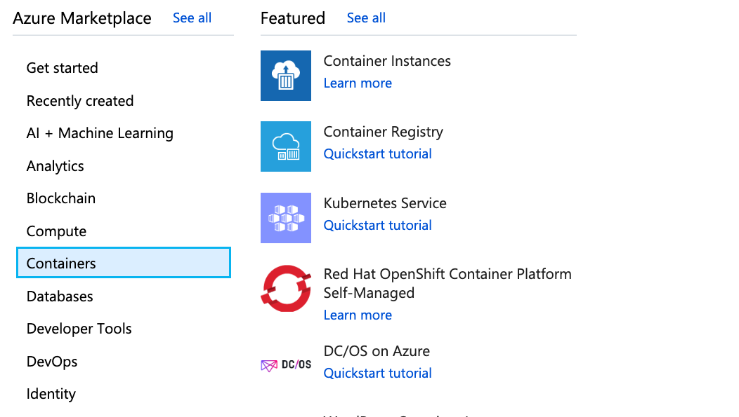
Azure Container Service (AKS)
Create an AKS cluster via the Azure portal
All functions available via the portal and Azure CLI
Notes:
- Select create new from the left side > Containers > Kubernetes Service
- Alternatively you may use the search box as well and use Kubernetes, Con

Slide 97
Azure Kubernetes Service (AKS)
Demo

Slide 98
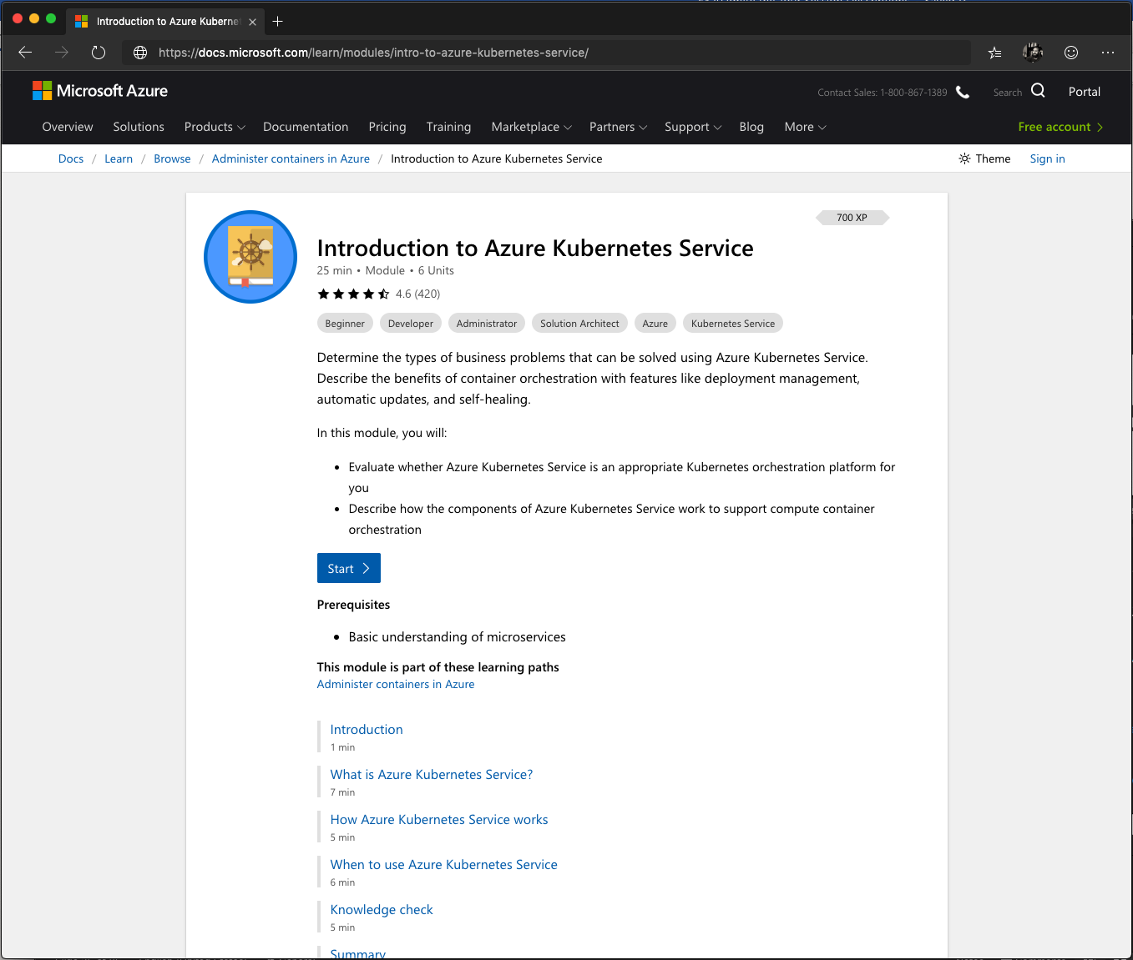
Microsoft Learn – Azure Kubernetes Service
aka.ms/AFUN60MSLearnCollection
Evaluate whether Azure Kubernetes Service is an appropriate Kubernetes orchestration platform for you
What is AKS?
When to use Azure Kubernetes Service
How does it work?

